Slide 1

2020 Election Q&A
Jessica Blair, Communications Director/City Clerk
Jonathan Roisman, Deputy City Clerk
June 25, 2020
City of Half Moon Bay

Slide 2
Information for Voters
Jonathan Roisman, Deputy City Clerk

Slide 3
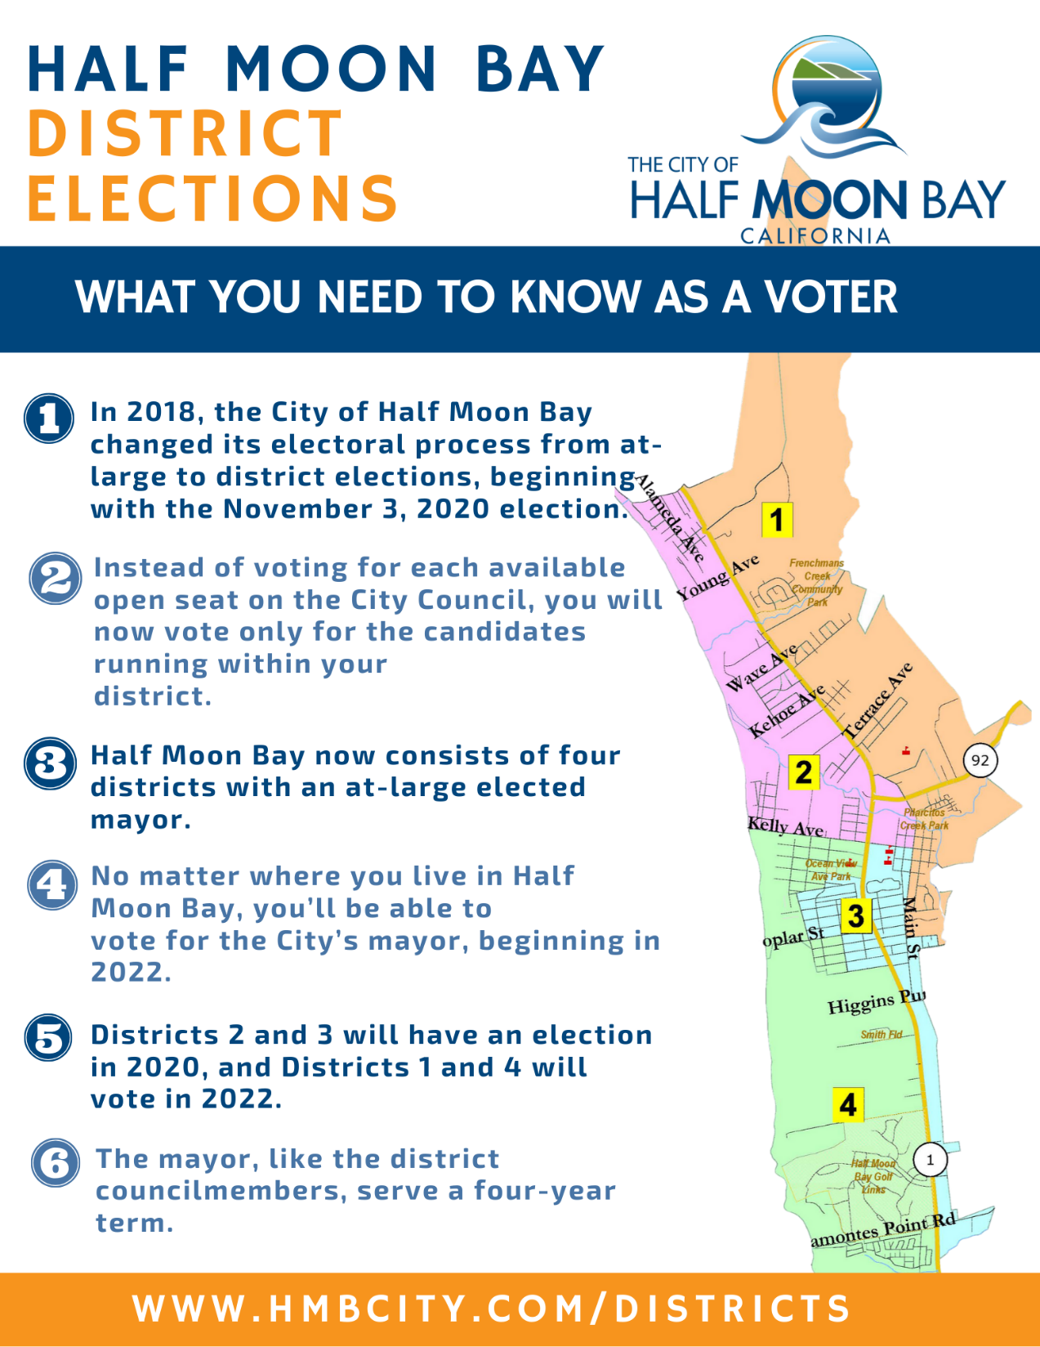

Slide 5
All-Mail Ballot Process
SB 450 – Voter’s Choice Act
All registered voters will be mailed a ballot between October 5-27
Mail, drop off at a ballot drop box, or drop off at Vote Center
If you do not receive a ballot, you can request one from the County or pick one up at any Vote Center in the County

Slide 6
Vote Centers / Ballot Drop Boxes
4-Day Vote Center (location TBD)
Ballot Drop Boxes beginning October 6
City Hall
Half Moon Bay Library
Senior Center (not open to public, for senior residents only)
Link to other ballot drop boxes in the county:
https://www.smcacre.org/ballot-drop-box-locations

Slide 7
Voter Registration / Conditional
Regular voter registration deadline is Monday, October 19
Conditional voter registration
At a Vote Center, you can register to vote by filling out a paper form or by filling out an online form. You will be given a provisional ballot that will count once your eligibility is verified.
Pre-Registration starting at 16 years old
Register to vote: https://registertovote.ca.gov/

Slide 8
Information for Candidates
Jessica Blair, Communications Director / City Clerk

Slide 9
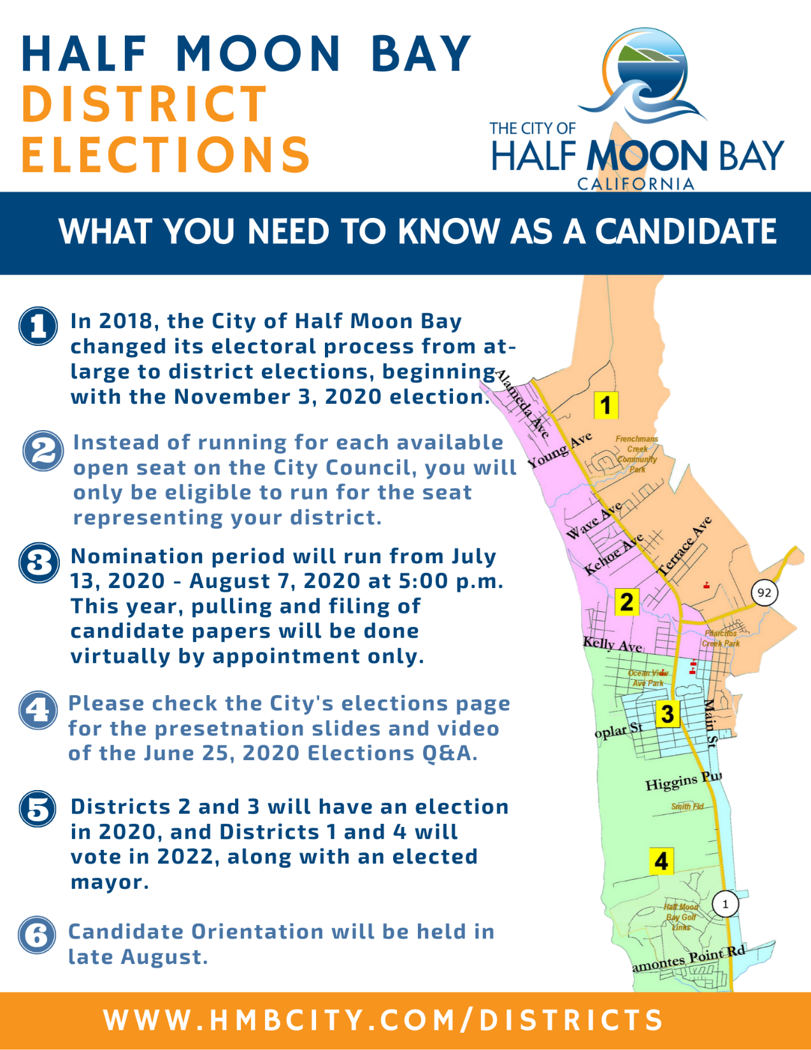

Slide 10
General Information
For the November 3, 2020, only registered voters from Districts 2 and 3 will be able to run for an open seat. The candidate elected will then serve as the district councilmember for that district for a term of four years.
Councilmembers attend all City Council meetings, may be appointed to subcommittees and outside agencies, attend a variety of interagency meetings and events, as well as other commitments.
Questions regarding time commitment, process, protocols, etc. may be asked during the paper pulling appointment.
City staff will onboard new councilmembers and support them during the transition to becoming an elected official.
Candidate Orientation will be held virtually in late August.

Slide 11
Nomination Procedures
Nomination papers and all election forms will be provided electronically by the City Clerk or Deputy City Clerk – pulling and filing papers will be done by appointment only via Zoom / email. Email jblair@hmbcity.com and jroisman@hmbcity.com to set up an appointment.
Physical nomination papers will not be provided, but wet signatures are still required.
The entire packet with wet signatures must be received by City Hall by Friday, August 7, 2020 at 5:00 p.m. via mail or physical drop-off.
Campaign Finance Forms will now be filed electronically via NetFile

Slide 12
Nomination Procedures
Candidates may be nominated by signatures of not less than 20 and no more than 30 registered voters from their district.
Suggested ways of gathering signatures during the pandemic:
Throw a “bring your own pen” party with a table in your driveway during a set time and ask those who wish to sign to bring their own pens and sign the form – make sure to maintain social distancing and wear face coverings.
Email the nomination form to interested signatories and have them drop off or mail their wet signatures to you.

Slide 13
Questions?
Contact information
Jessica Blair, Communications Director/City Clerk
jblair@hmbcity.com
650-726-8271
Jonathan Roisman, Deputy City Clerk
jroisman@hmbcity.com
650-726-8266

