Slide 1
City Council Meeting November 4, 2025

Slide 2
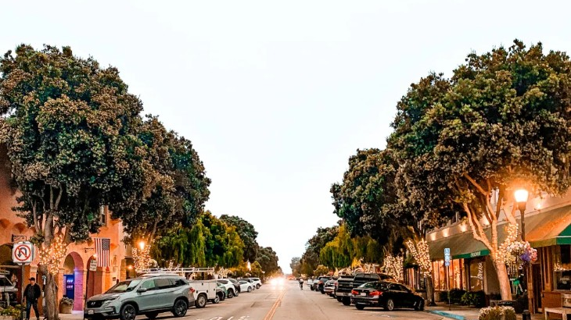

Commercial Vitality Ordinance First Reading City Council | November 4, 2025
Notes:
Purpose: to present the draft ordinance, receive feedback, and confirm next steps.

Slide 3
Background & Purpose
Feedback
Council Priority Workshop, listening sessions, study session
Concerns
Vacant/neglected storefronts lead to
- Urban decay
- Reduced property values
- Safety risks
Goal
Preserve HMB’s aesthetic, economic, and social vitality

Slide 4
What the ordinance does
Sets standards for empty and neglected storefronts and all commercial property exteriors.
Requires property owners to notify the City when storefronts become vacant.
Establishes maintenance and display standards.
Provides enforcement tools to address chronic neglect.
Notes:
Collaborative, not punitive.

Slide 5
Balanced Approach
Balance accountability with education and collaboration.
Tailored to local scale and staffing capacity.
Focus on simple reporting and easy compliance.
Developed with input from stakeholders.
Notes:
This model is right-sized for Half Moon Bay.

Slide 6
Study Session – Oct. 7
Unanimous support for the concept.
General support for honoring the uniqueness of storefronts.
Desire to avoid overly prescriptive regulations.
Emphasis on merchant’s pride / ownership and education on proper maintenance practices.
Desire for more specificity around the role of the Compliance Officer.

Slide 7
Key Revisions: Cleanliness and Maintenance
New provisions address overall property cleanliness and upkeep.
Clean awnings and legible exterior lettering.
Dumpsters and trash cans must remain enclosed.
No trash or waste left outside receptacles.
Regular cleaning of exteriors, interiors, sidewalks, and parking areas.
Notes:
New revisions address overall property cleanliness and upkeep

Slide 8
Clarifying Standards
Rather than defining “blight,” the ordinance sets specific maintenance and upkeep requirements.
Establishes clear, enforceable standards for consistency.
References existing City Code and State Health and Safety Code provisions.
Provides the Compliance Officer with flexible yet firm
enforcement tools.

Slide 9
Vacant Storefronts
Section 7.65.040(B)(7) updated with examples for temporary window displays.
Applies to street-facing windows vacant 90+ days.
Incorporated into Empty Storefront Registration Form to facilitate discussion with Compliance Officer.
Notes:
Goals:
Encourage active, visually appealing storefronts
Reduce regulatory burden on property owners
Minimize ongoing staff involvement

Slide 10
Next Steps
First Reading and Introduction
Second Reading
Ordinance Effective 30 Days After Adoption

Slide 11
Clarifying Questions

Slide 12
City Council Meeting November 4, 2025

