Slide 1
City of Half Moon Bay City Council
November 4, 2025

Slide 2
Housing Element
Public Hearing – November 4, 2025

Slide 3
Recommendation
Receive public input and evaluate revisions to the 2023-2031 (6th Cycle) Housing Element.
Adopt the Mitigated Negative Declaration for the 2023-2031 (6th Cycle) Housing Element and adopt the Housing Element dated October 2025 for review by the California Department of Housing and Community Development.
Notes:
Notice of intent is submitted along with a checklist that include a checklist of eligibility criteria

Slide 4
Recommendation
Adopt the Mitigated Negative Declaration for the 2023-2031 (6th Cycle) Housing Element and adopt the Housing Element dated October 2025 for review by the California Department of Housing and Community Development, with the following amendments to Program 6-8
  Remove the sentence: Measure D, as currently enforced through Section 8 of the Measure, is only applicable to the extent that it is judicially determined to be in compliance with State law.
  Remove all references to a ballot measure.
Notes:
Notice of intent is submitted along with a checklist that include a checklist of eligibility criteria

Slide 5
Background
Housing Element is one of nine required General Plan Elements
Updated every 8 years
Certified by California Department of Housing and Community Development (HCD)

Slide 6
Background
Housing Element must
Identify & analyze existing and projected housing needs
Affirm goals, policies, and objectives
Identify financial resources and housing constraints
Outline programs for preservation, improvement, and housing development
Identify housing sites to meet Regional Housing Needs Allocation (RHNA)

Slide 7
Half Moon Bay RHNA
Income Category | RHNA Allocation
Very Low | 181
Low | 104
Moderate | 54
Above Moderate | 141
Total | 480

Slide 8
Timeline
Public Outreach
March 2021 –
April 2023
1st through 3rd Drafts
May 2023 –
Dec 2024
HCD Comments Received
Nov 2024
4th Draft to PC & CC
Respond to HCD comments
(not Measure D)
Jan – March 2025
HCD Comments Received
May 2025
Draft 5 & MND
to PC & CC
Respond to all HCD comments
Oct - Nov 2025

Slide 9
HCD May 2025 Requested Revisions
Clarify remaining steps needed for some of the “pipeline” sites under development.
      Proposed Response: Add additional information about non-governmental constraints (economic constraints), and additional information on a site-by-site basis.
Add information on environmental constraints that might preclude development.
      Proposed Response: Add paragraph describing overall environmental constraints in Half Moon Bay, noting the city lies within the Coastal Zone.

Slide 10
HCD May 2025 Requested Revisions
If site updates are made, they must be reflected in the Site Inventory.
      There are no changes in the sites, therefore this comment is not applicable.
Add additional language on potential interventions to support supportive housing, regarding emergency shelters.
      Proposed Response: Add suggested language
Add additional information on approval times for typical developments.
      Proposed Response: Add sentence to clarify that recent development patterns are typical concerning approval times, and a program to monitor approval times.

Slide 11
HCD May 2025 Requested Revisions
Revise Program 6-8 to provide alternative actions if there is no amendment to the LCLUP.
      Proposed Response: Revise Program 6-8 to include discussion of a 2028 ballot measure to revise Measure D, and to seek other measures as necessary if 2028 ballot measure fails.

Slide 12
Measure D Changes – Code Amendment
Seek approval of a Local Coastal Program Amendment to revise the allocation requirements for ADUs and JADUs, from a full allocation per unit to a lesser amount, such as a partial allocation of 0.5 or amount considered reasonable by the City.
Reallocate unused Measure D allocations for ADUs and affordable housing units by rolling over those allocations to the next year for which no building permit is applied
Notes:
Title 14 does not require coastal commission certification, thus would not require CCC cert.

Slide 13
Measure D Changes – Ballot Measure
Revise to define “Downtown Area” as the area designated as the Town Center in the Certified Local Coastal Land Use Plan
Exempt Accessory Dwelling Units (ADUs), including Junior Accessory Dwelling Units (JADUs) from Residential Dwelling Unit Allocation limitations
Notes:
Title 14 does not require coastal commission certification, thus would not require CCC cert.

Slide 14
CEQA
Initial Study Prepared
Mitigated Negative Declaration
    Public Period: Sept 9, 2025 – Oct 9, 2025
    No impact or less than significant impact with mitigation measures
Mitigation
  Nesting Bird Protection

Slide 15
Thank you

Slide 16
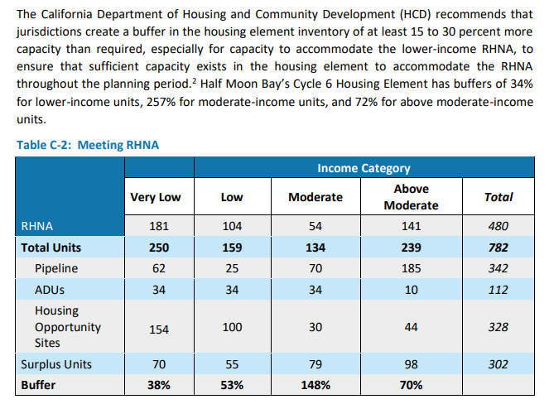
RHNA Buffer

Slide 17
Background
Housing Element must provide for
Large and multigenerational households
Small households and senior
Special housing needs groups
Bay variety of ways
Factory built units
Mobile homes
Emergency housing
Housing near transit

